Slide 1
Examples of Specific Laser Systems
Gas Lasers
  CO₂ (9-10 μm), High Power
  He:Ne (632 nm) , Ar (ion) Laser (520 nm)
  Excimer (UV) Lithography
Solid-State Lasers
Nd:YAG , Ti:Sapphire (Ultrafast Revolution)
Fiber Lasers (Rare-Earth Doped Fiber Lasers)
Yb³⁺ (10+ kW), Tm³⁺ , Ho³⁺ (2 μm), Er³⁺ (1.5 μm)
Dye Lasers
Chemical Lasers
COIL (7+kW), MIRACL (>1 MW !!)
Semiconductor Lasers

Slide 2
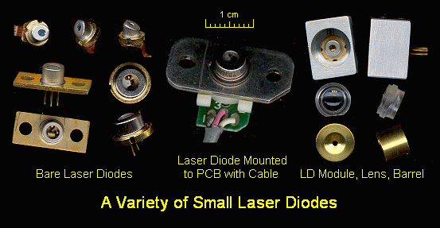
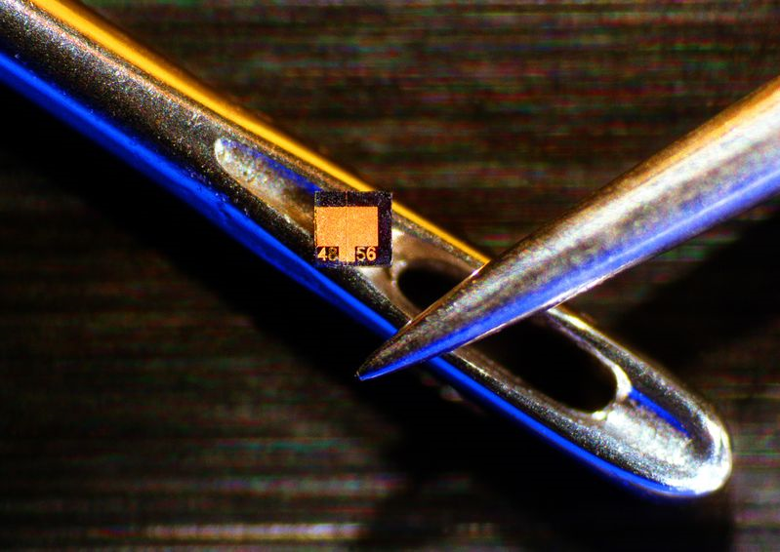
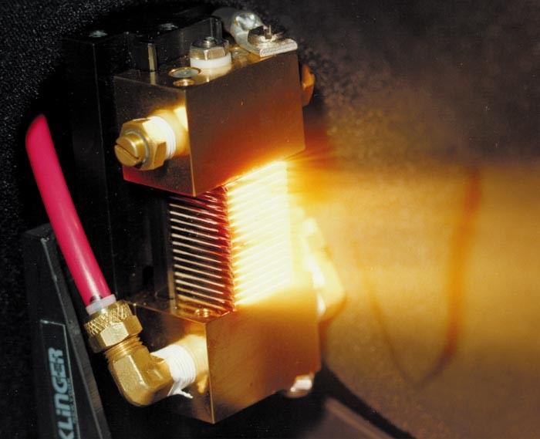
Semiconductor Lasers

Slide 3
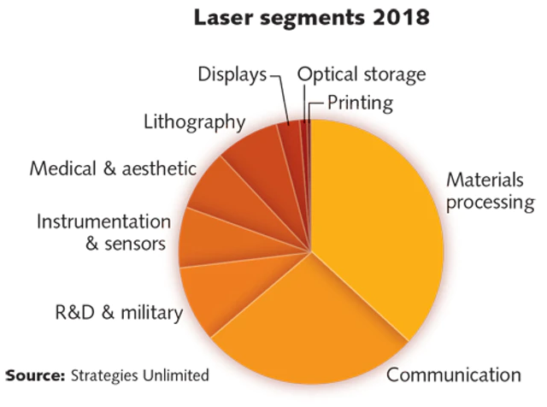
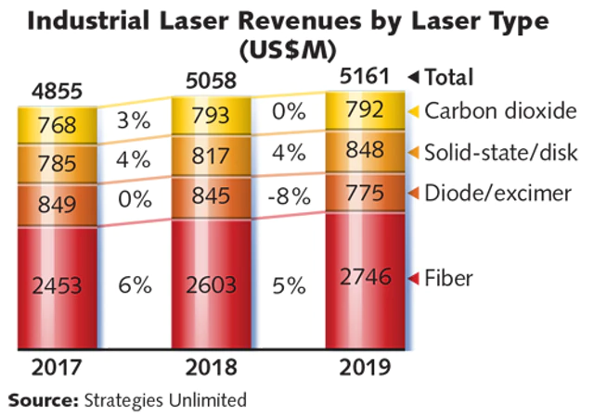
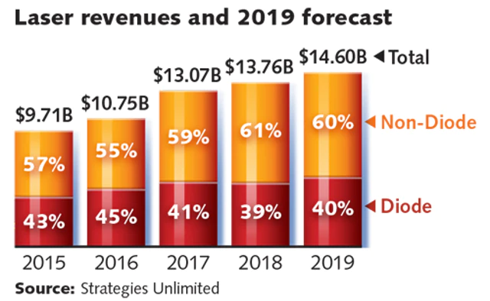
Laser Market and Applications

Slide 4
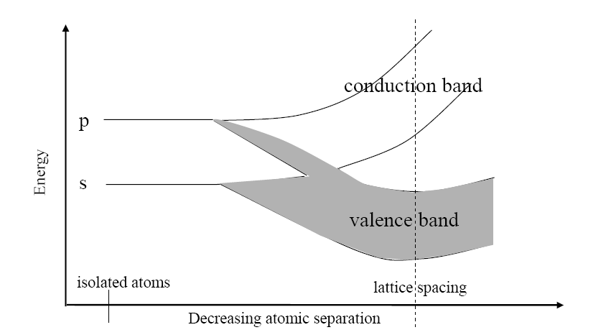
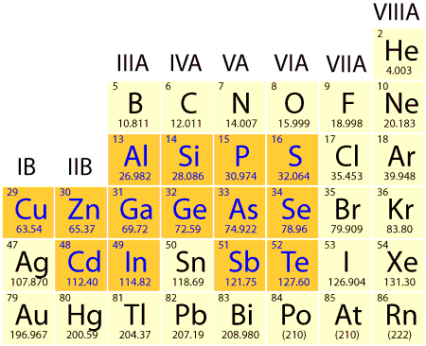
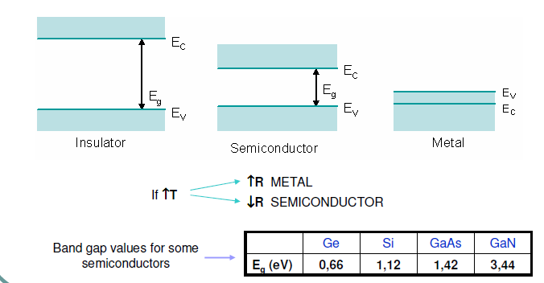
What is a semiconductor?

Slide 5
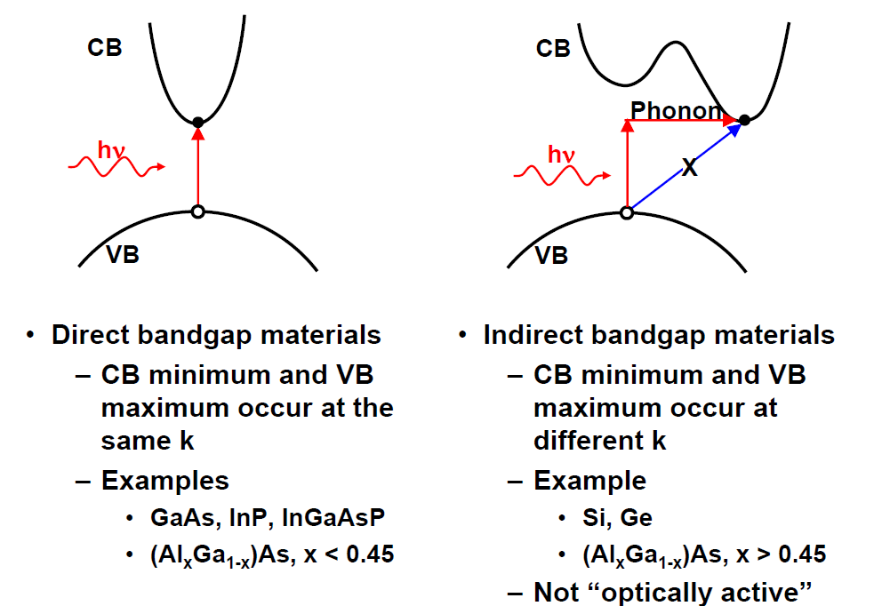
Direct-Gap vs. Indirect-Gap
E(energy)
k (momentum)

Slide 6
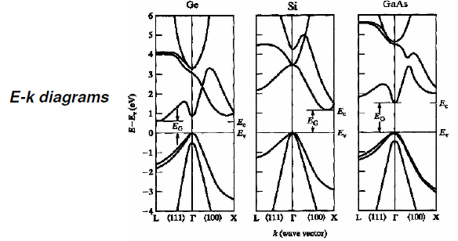

Slide 7
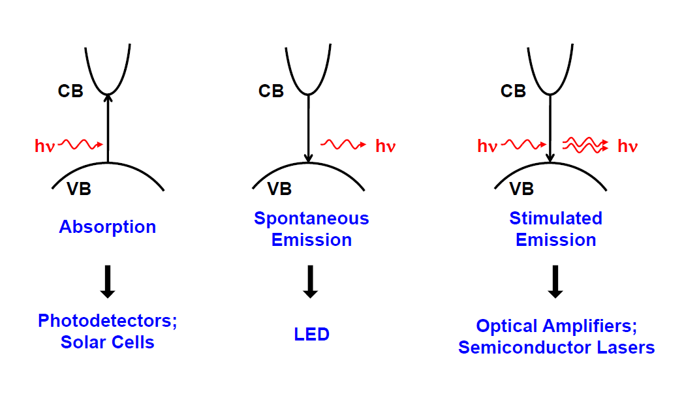
Optical Interactions in a Direct-Gap Semiconductor

Slide 8
A Brief Introduction to Semiconductors
Energy Bands
E
1 0
Equilibrium
Fermi-Dirac Statistics
http://britneyspears.ac/lasers.htm !!!???

Slide 9
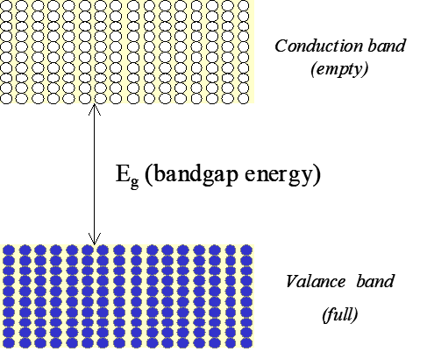

Nonequilibrium Electron-Hole Injection
10⁴ cm⁻¹
Example
GaAs
E_{g}=1.4 eV
(λ_{g}=850 nm)
Absorption
0
Gain
$$E_{g}$$
hω

Slide 10
p-n junctions
Doping with Impurities
n-type
p-type
E_{f}
E_{g}
E_{g}
E_{f}
Examples: GaAs doped with Br
Si doped with P
Examples: GaAs doped with Zn
Si doped with Al

Slide 11
Semiconductor junction lasers
Forward-Biased p-n Junction (LED)
n⁺-GaAs
p⁺-GaAs
+ V
d
Inversion (Gain) Layer
Current Density Threshold
Recombination time

Slide 12
Section 12.2 p.2
Edge-Emitting Homojunction Laser Diodes
L_{g}≅100 μm
Waveguide Modes
Homojunction Lasers have very high current threshold mainly because.
Electrons and holes are free to diffuse and therefore dilute the gain (no carrier confinement)
Optical mode has poor overlap with gain (no optical confinement or guiding)

Slide 13
12.3 Heterojunction Lasers Diodes
A fortunate coincidence:
n when E_{g}
electrons
^{n+}
^{AlGaAs}
GaAs
^{p+}
^{AlGaAs}
Energy
Carrier confinement
holes
holes
100 nm
Index of Refraction
Mode confinement

Slide 14
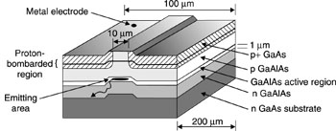
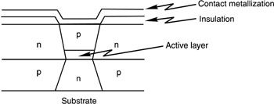
Section 12.3 p.2
Edge-Emitting Heterojunction Laser Diodes
Edge-Emitting Buried Heterojunction Laser Diodes

Slide 15
12.4 Quantum Well Lasers
Multiple Quantum Well (MQW) Lasers
^{n+}
^{AlGaAs}
10 nm
^{p+}
^{AlGaAs}
mode confinement
Epitaxial Growth

Slide 16
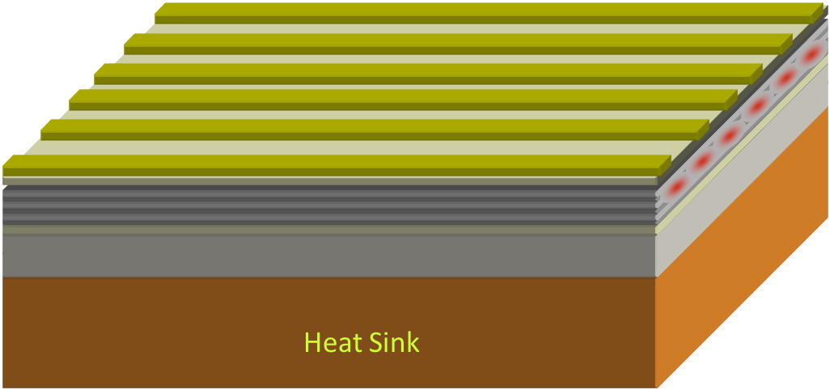
Section 12.4 p.2
High Power Diode Bars
P>100 W (cw)
Diode-pumping solid-state lasers (DPSS)
Material Processing
…

Slide 17
Section 12.4 p.3
Vertical Cavity Surface Emitting Lasers (VCSEL)
Good mode quality couples to fiber efficiently for telecom applications
Single mode operation
2-D structures cam be made
Low power

Slide 18
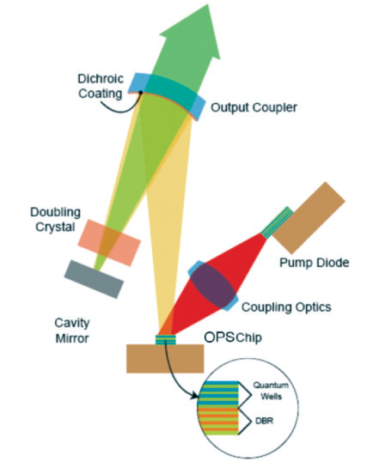
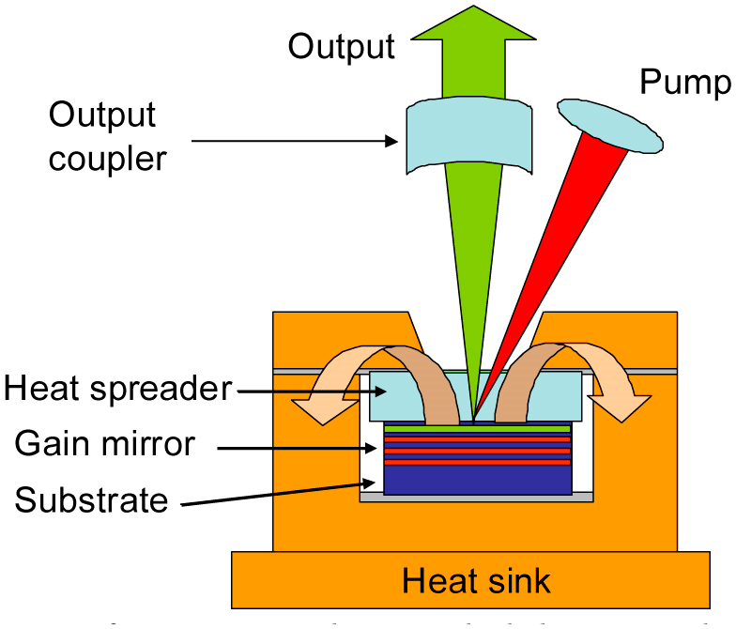
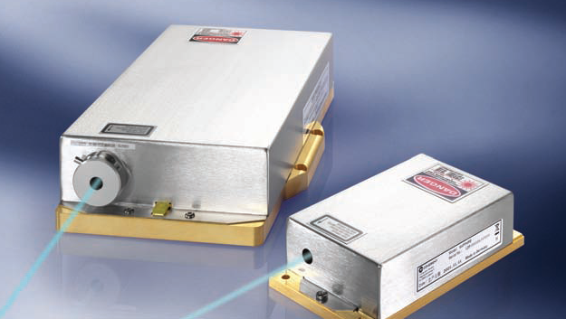
Optically-Pumped Semiconductor Lasers (OPSL)

Slide 19
Section 12.4 p.4
Laser Diodes Cover the Spectrum
Compound | Spectral Region | Notes
Al_{x}Ga_{1-x}N GaN In_{x}Ga_{1-x}N | uv uv (350 nm) blue (480-400 nm) | data storage, display
Ga_{x}I_{1-x}P (x=0.5) Ga_{x}Al_{1-x}As (x=0-0.45) | 670 nm 620-895 nm | display
GaAs In_{x}Ga_{1-x}As (x=0.2) | 904 nm 980 nm | diode pumping solid-state and fiber lasers.
In_{x}Ga_{1-x}As_{y}P_{1-y} (x=0.73, y=0.58) (x=0.58, y=0.9) | 1100-1650 1310 nm 1550 nm | Telecom
PbSSe | 4200-8000 nm | cryogenic
PbSnTe | 6300-29,000 nm | cryogenic

Slide 20
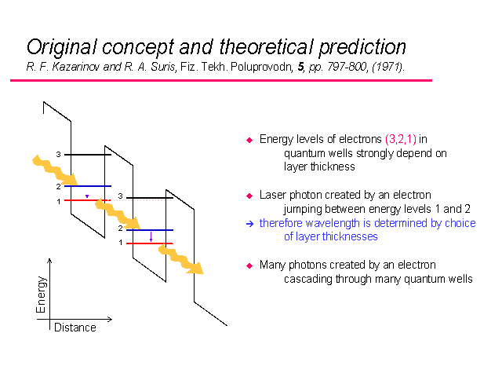
Quantum Cascade Lasers (QCL)

Slide 21
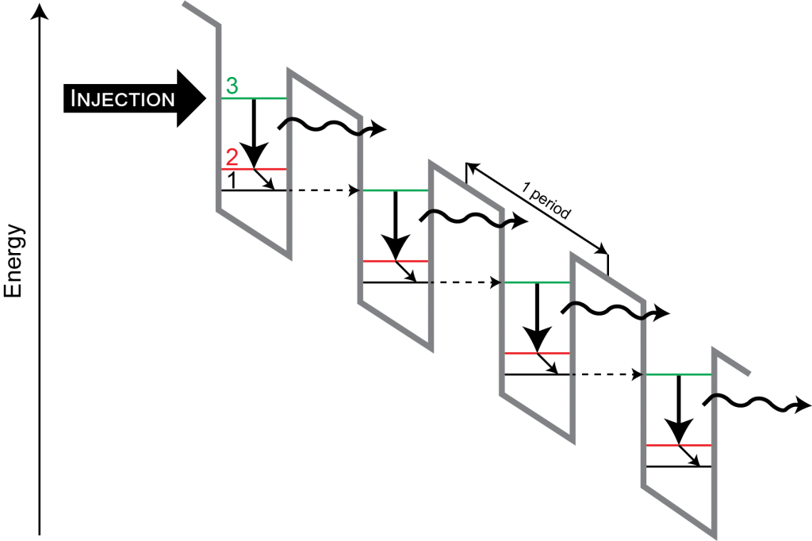
Quantum Cascade Lasers (QCL)

Slide 22
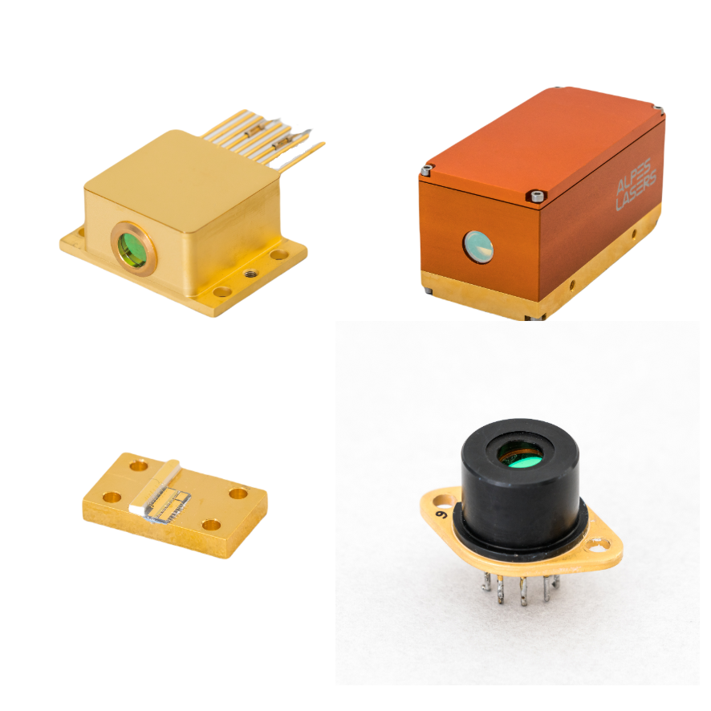
Quantum Cascade Lasers (QCL)

Slide 23
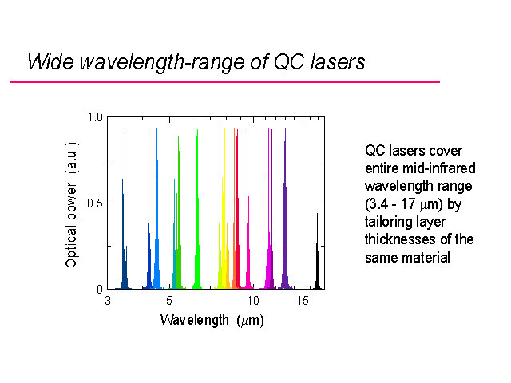
Quantum Cascade Lasers (QCL)

Slide 24
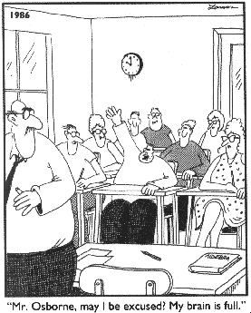
THE END !

